Slide 1
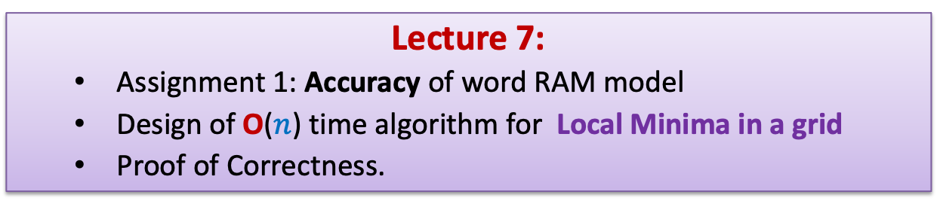
Data Structures and Algorithms (ESO207A)
Lecture 7:
Assignment 1: Accuracy of word RAM model
Design of O($n$) time algorithm for Local Minima in a grid
Proof of Correctness.

Slide 2
Optional session
Practice sheet on Time complexity and big “O” notation
Time: 11:00 AM, 13 August, 2022.
Venue : KD101.
Please attempt problems first and then only come ☺
Otherwise, you won’t learn much from this session.

Slide 3

Fibonacci numbers
Fibonacci numbers
$F(0) = 0$;
$F(1) = 1$;
$F(n) = F(n−1) + F(n−2)$for all $n >1$;
$F(n)$ $>$ $2^{\frac{n−2}{2}}$
Simple exercise:
Using induction or otherwise, show that

Slide 4
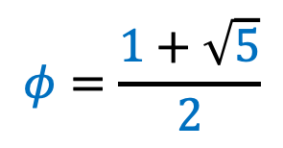



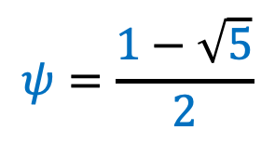
Fibonacci numbers
Fibonacci numbers
$F(0) = 0$;
$F(1) = 1$;
$F(n) = F(n−1) + F(n−2)$for all $n >1$;
$$F\left(n\right)=\frac{φ^{n} −ψ^{n}}{\sqrt{5}}$$
$$\left|F\left(n\right)−\frac{φ^{n}}{\sqrt{5}}\right|<1$$
$$φ=\frac{1+\sqrt{5}}{2}$$
where
$$≈1.61803$$
$$ψ=\frac{1−\sqrt{5}}{2}$$
$$≈−0.61803$$

Slide 5
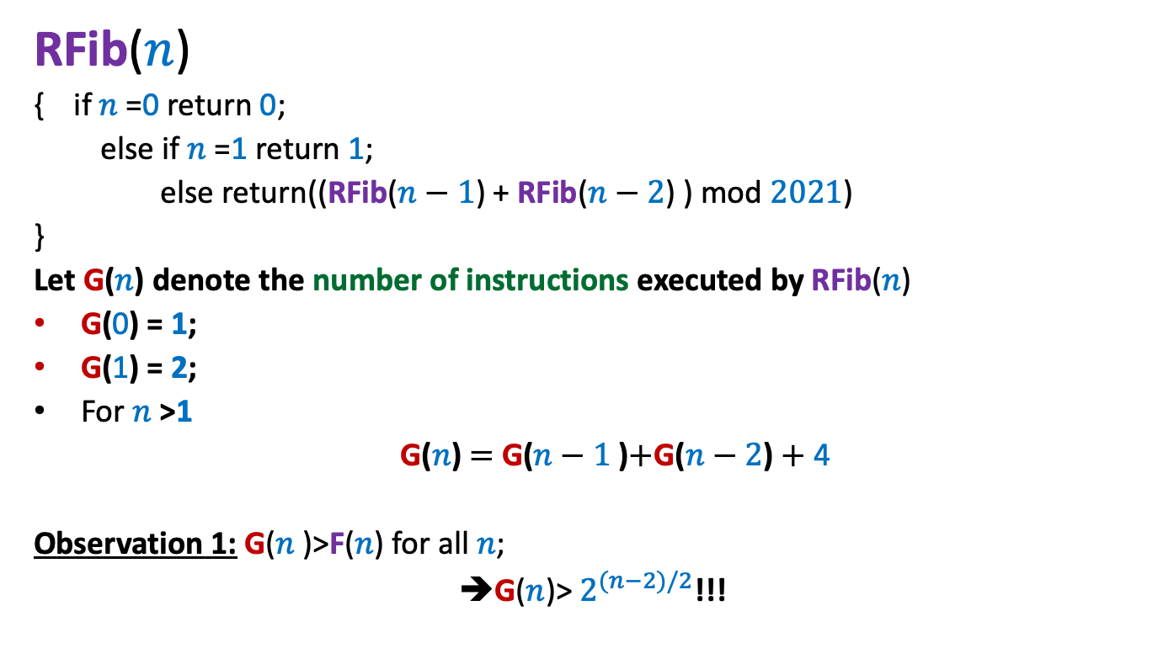

Recursive algorithm for F($n$) mod 2021
RFib($n$)
{ if $n$=0 return 0;
else if $n$=1 return 1;
else return((RFib($n−1$) + RFib($n−2$) ) mod $2021$)
}
Let G($n$) denote the number of instructions executed by RFib($n$)
G(0) = 1;
G(1) = 2;
For $n$>1
G($n$) $=$ G($n−1$)$+$G($n−2$) $+$ 4
Observation 1: G($n$)>F($n$) for all $n$;
➔G($n$)> $2^{(n−2)/2}$!!!

Slide 6
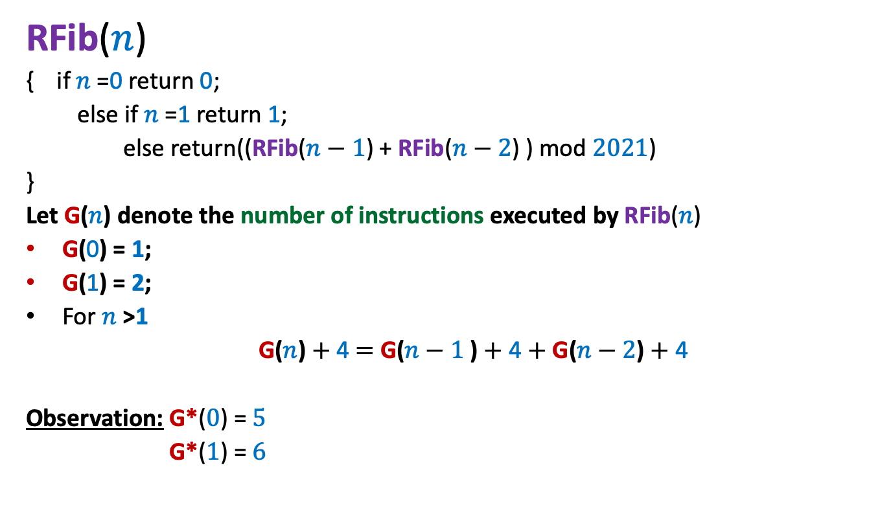




Recursive algorithm for F($n$) mod 2021
RFib($n$)
{ if $n$=0 return 0;
else if $n$=1 return 1;
else return((RFib($n−1$) + RFib($n−2$) ) mod $2021$)
}
Let G($n$) denote the number of instructions executed by RFib($n$)
G(0) = 1;
G(1) = 2;
For $n$>1
G($n$) $+$ 4 $=$ G($n−1$) $+$ 4 $+$ G($n−2$) $+$ 4
Observation: G*($0$) = $5$
G*($1$) = $6$
G*($n$)
G*($n$) $≤$F($n+5$)
For $n >$ 1,
G*($n$) $=$ G*($n−1$) $+$ G*($n−2$)

Slide 7

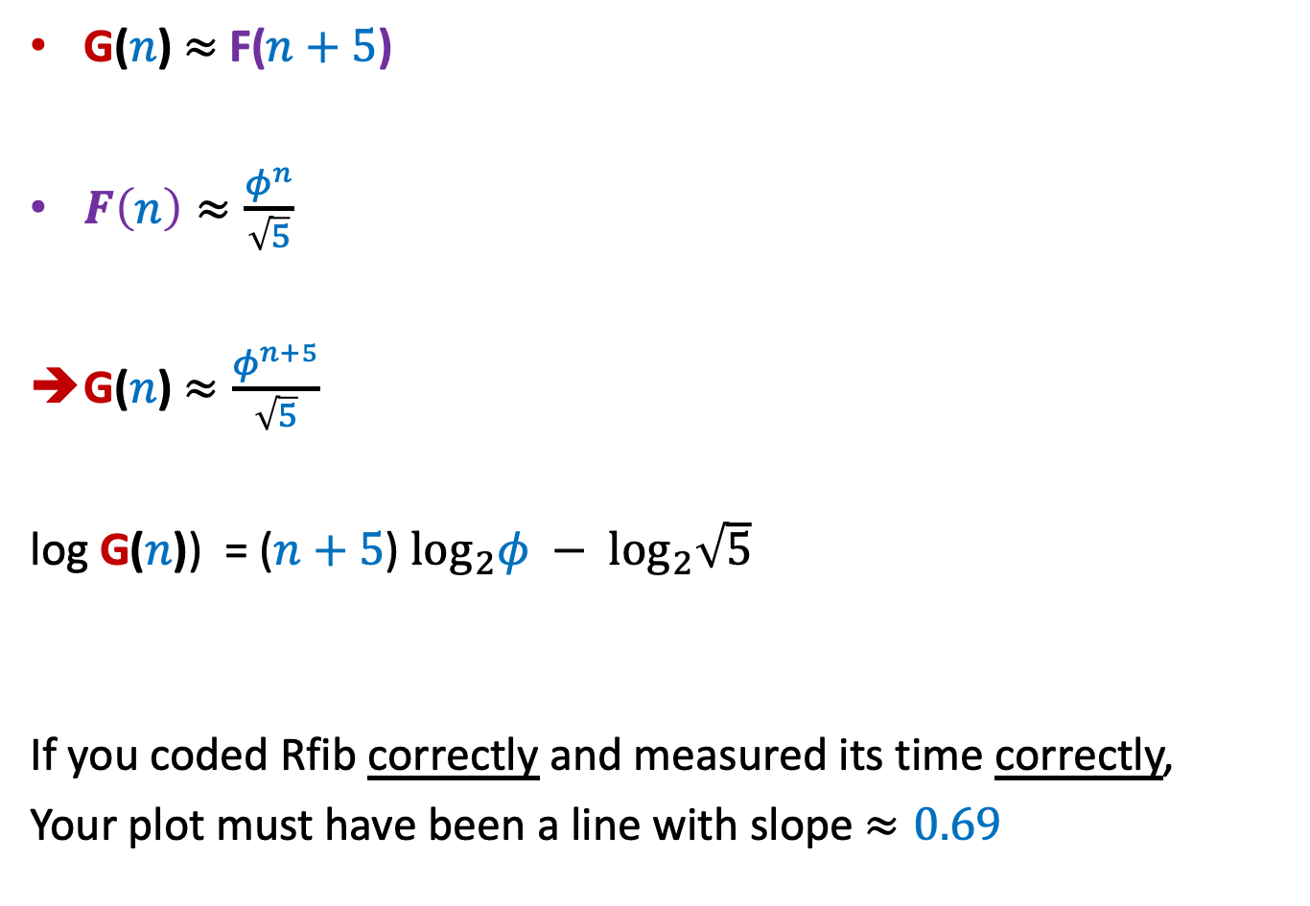

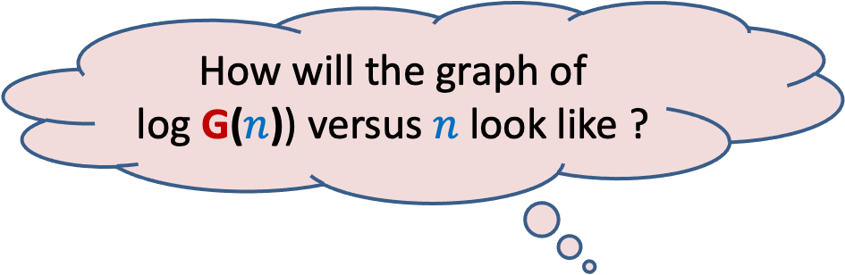

RAM model is quite an accurate model
for measuring efficiency of an algorithm
G($n$) $≈$F($n+5$)
$F\left(n\right)≈\frac{φ^{n}}{\sqrt{5}}$
G($n$) $≈\frac{φ^{n+5}}{\sqrt{5}}$
log G($n$)) = ($n+5$) $\log_{2}φ − \log_{2}\sqrt{5}$
If you coded Rfib correctly and measured its time correctly,
Your plot must have been a line with slope $≈0.69$
$$φ≈1.61803$$
How will the graph of
log G($n$)) versus $n$ look like ?
A line with slope $\log_{2}{φ}$
$$\log_{2}{φ}=0.69…$$

Slide 8
Proof of Correctness

Slide 9
What does correctness of an algorithm mean ?
For every possible valid input,
the algorithm must output correct answer.
Let us take a toy algorithm ☺

Slide 10
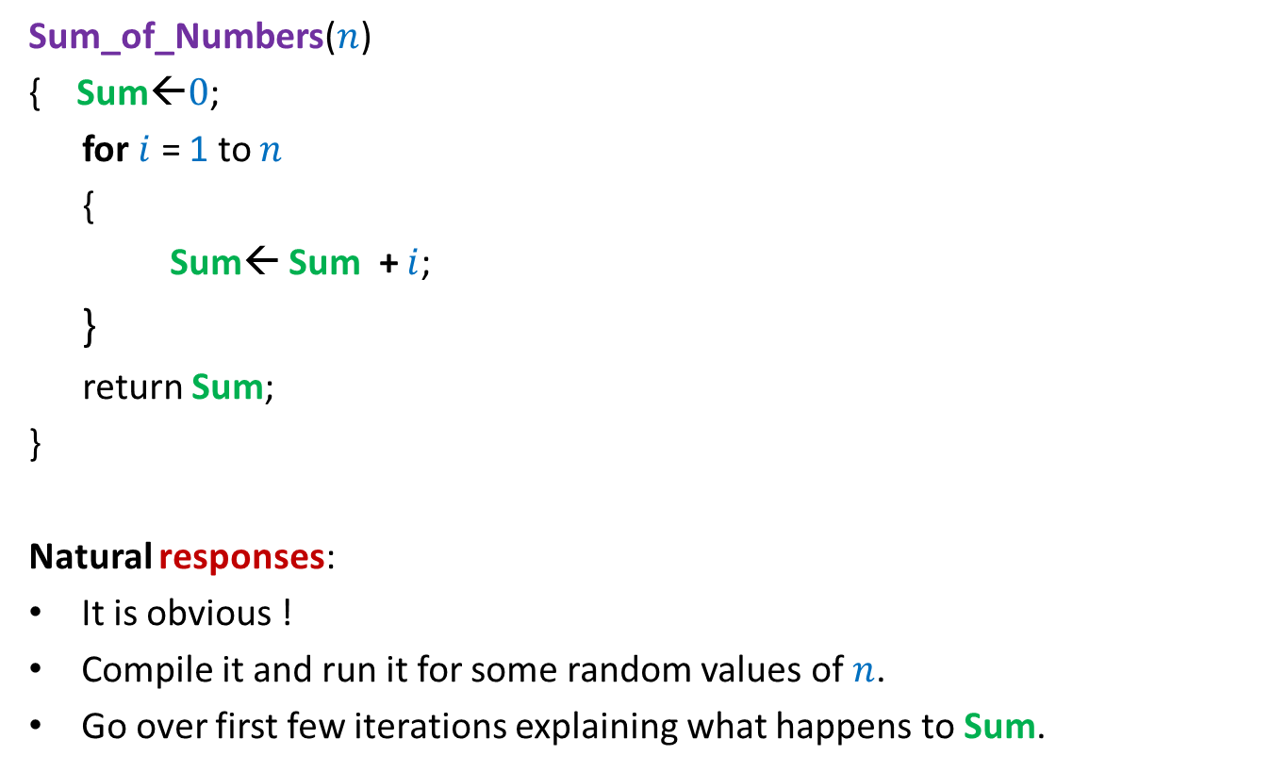

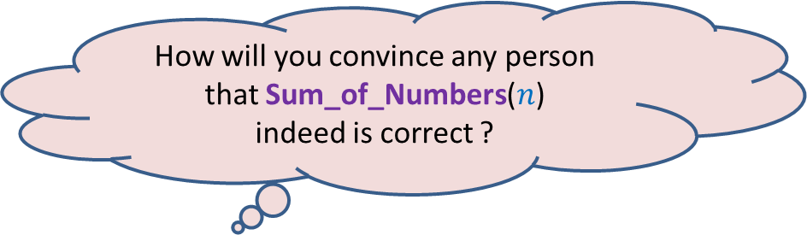
Algorithm for computing sum of numbers from $0$ to $n$
Sum_of_Numbers($n$)
{ Sum←$0$;
for $i$ = 1 to $n$
{
Sum← Sum + $i$;
}
return Sum;
}
Natural responses:
It is obvious !
Compile it and run it for some random values of $n$.
Go over first few iterations explaining what happens to Sum.
How will you convince any person that Sum_of_Numbers($n$)
indeed is correct ?

Slide 11
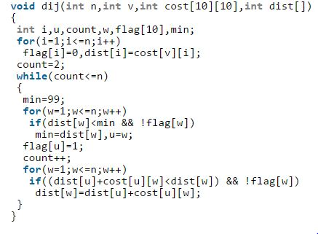
How will you respond
if you have to do it for the following code ?

Slide 12
Think for some time to realize
the non-triviality
the Importance
of proof of correctness of an iterative algorithm.
Interestingly, such a proof will be just
Expressing our intuition/insight of the algorithm
In the following slide, we present an overview of the proof of correctness.
in a formal way ☺.

Slide 13




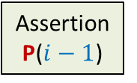
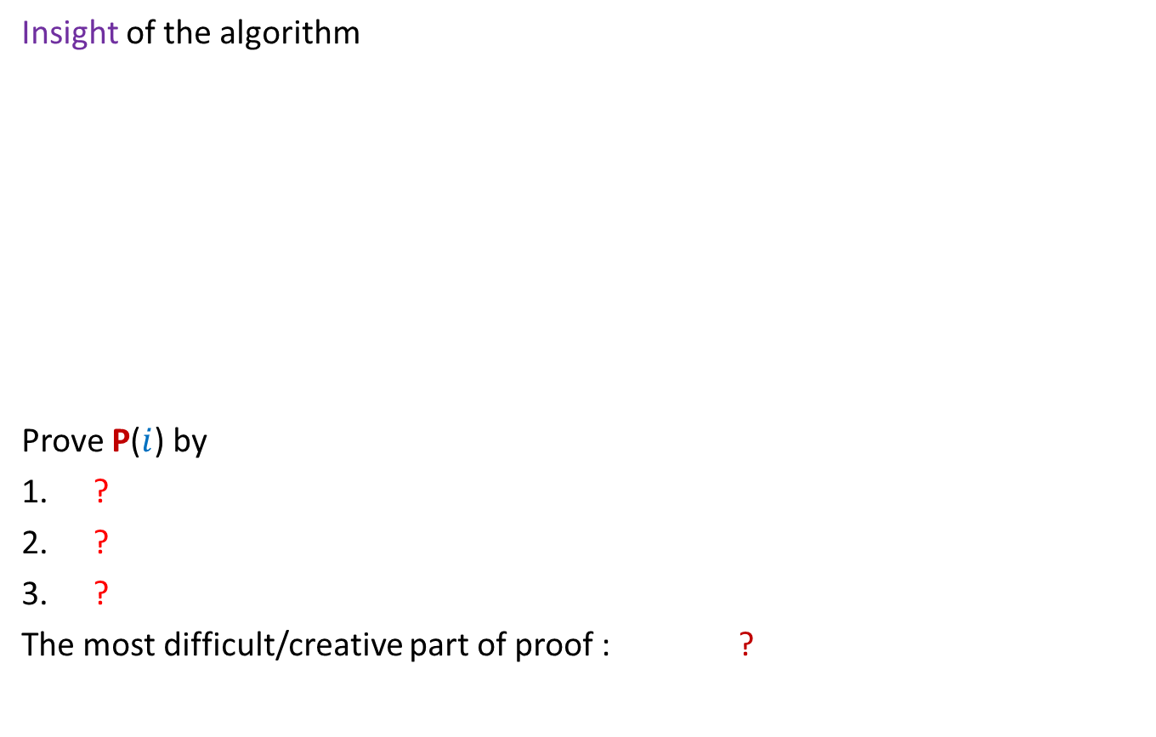

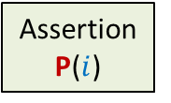





Proof of correctness
For an iterative algorithm
Insight of the algorithm
Prove P($i$) by
?
?
?
The most difficult/creative part of proof : ?
Theorem
Assertion
P($i−1$)
Assertion
P($i$)
Start
of Loop
$$i−1$$
$$i$$
Iterations
$$1$$
$$2$$
$$3$$
$$4$$
What would you expect at the end of $i$th iteration ?
Assuming P($i−1$)
Theorem
Proof by induction
Body of the Loop
To come up with the right assertion P($i$)

Slide 14
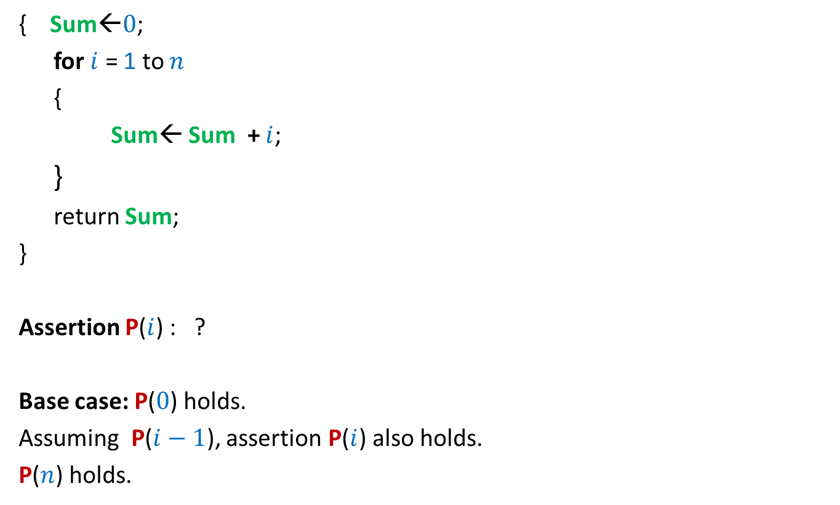
Algorithm for computing sum of numbers from $0$ to $n$
{ Sum←$0$;
for $i$ = 1 to $n$
{
Sum← Sum + $i$;
}
return Sum;
}
Assertion P($i$) : ?
Base case: P($0$) holds.
Assuming P($i−1$), assertion P($i$) also holds.
P($n$) holds.
At the end of $i$th iteration Sum stores the sum of numbers from $0$ to $i$.

Slide 15
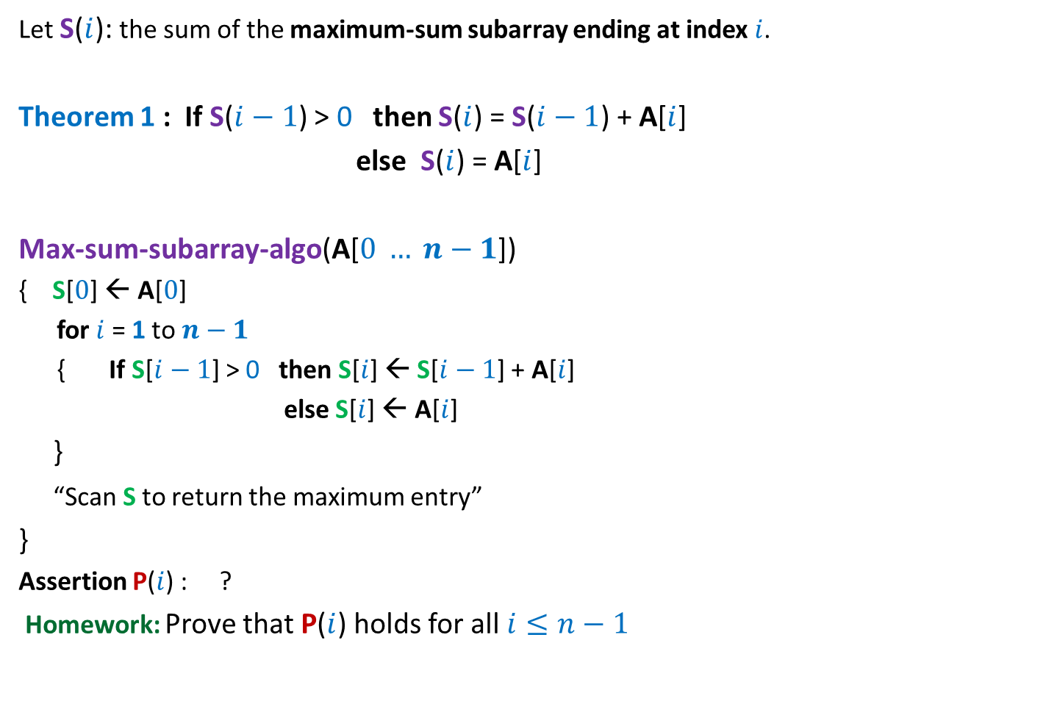
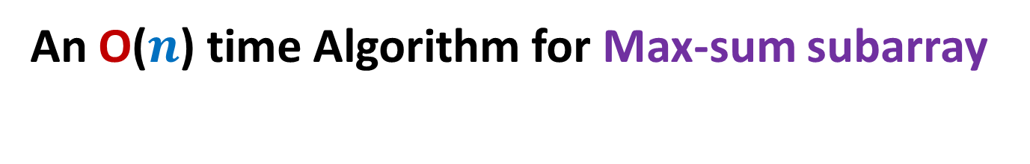
An O($n$) time Algorithm for Max-sum subarray
Let S($i$): the sum of the maximum-sum subarray ending at index $i$.
Theorem 1 : If S($i−1$) > 0 then S($i$) = S($i−1$) + A[$i$]
else S($i$) = A[$i$]
Max-sum-subarray-algo(A[$0 … n−1$])
{ S[$0$] ← A[$0$]
for $i$ = 1 to $n−1$
{ If S[$i−1$] > 0 then S[$i$] ← S[$i−1$] + A[$i$]
else S[$i$] ← A[$i$]
}
“Scan S to return the maximum entry”
}
Assertion P($i$) : ?
Homework: Prove that P($i$) holds for all $i≤n−1$
S[$i$] stores the sum of maximum sum subarray ending at A[$i$].

Slide 16
Recap from Lecture 6
An algorithm for Local Minima in a Grid

Slide 17



Local minima in a GRID
Definition: Given a $n$× $n$ grid storing distinct numbers,
an entry is local minima if it is smaller than each of its neighbors.
$$j$$
Does a local minima exist always ?
31
$$i$$
5
3
10
3
99
Yes. After all, global minima is also a local minima.

Slide 18


Local minima in a GRID
Problem: Given a $n$× $n$ grid storing distinct numbers, output any local
minima in $O$($n$) time.
$$j$$
31
$$i$$
5
3
10
3
99

Slide 19


A new approach
Repeat : if current entry is not local minima, explore the neighbor storing smaller value.
$$j$$
$$i$$

Slide 20
A new approach
Explore()
{ Let c be any entry to start with;
While(c is not a local minima)
{
c ← a neighbor of c storing smaller value
}
return c;
}
Question: What is the proof of correctness of Explore ?
Answer:
➔It suffices if we can prove that While loop eventually terminates.
➔Indeed, the loop terminates since we never visit a cell twice.

Slide 21


A new approach
Explore()
{ Let c be any entry to start with;
While(c is not a local minima)
{
c ← a neighbor of c storing smaller value
}
return c;
}
Time complexity : ?
How to apply this principle ?
$O$($n^{2}$)
First principle:
Do not discard Explore()
Second principle:
Simplify the problem
Homework of last class: Show that there is an instance of the grid
for which Explore() will indeed explore nearly $n^{2}$ cell.

Slide 22
Local minima in a GRID
How to simplify the problem ?

Slide 23
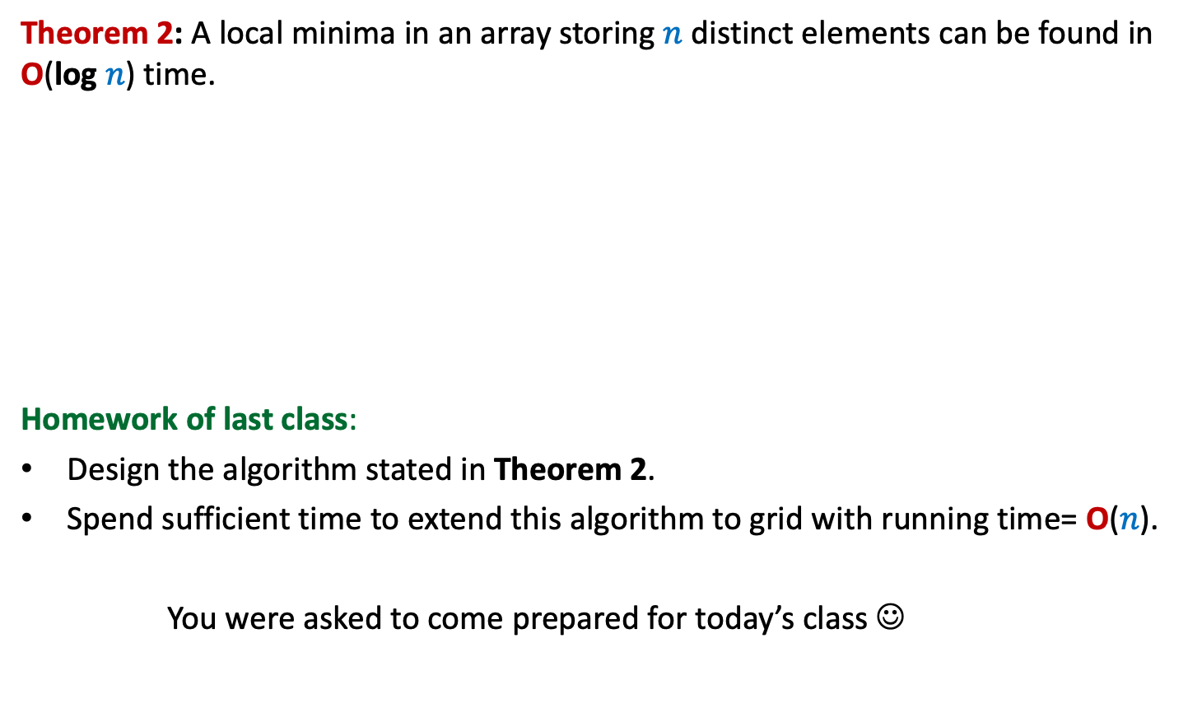
Local minima in a GRID
an ARRAY
Theorem 2: A local minima in an array storing $n$ distinct elements can be found in O(log $n$) time.
Homework of last class:
Design the algorithm stated in Theorem 2.
Spend sufficient time to extend this algorithm to grid with running time= O($n$).
You were asked to come prepared for today’s class ☺

Slide 24



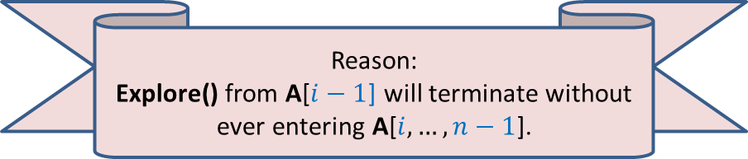

Algorithm for Local minima in an array
Execute Explore() from A[$i−1$]
We can discard A[$i,…,n−1$] ☺. But what if …
23
17
9
A
9 17 23
$$i$$
There is a local minima
in A[$0$,…,$i−1$]. Give reasons.
Reason:
Explore() from A[$i−1$] will terminate without ever entering A[$i,…,n−1$].

Slide 25

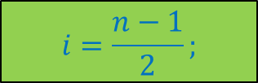
Algorithm for Local minima in an array
We can discard A[$0,…,i$] ☺.
What should be $i$ so that we always discard a significant portion of A ?
…Can you see the algorithm now ?...
$$i=\frac{n−1}{2};$$
A
23 17 9
$$i$$

Slide 26

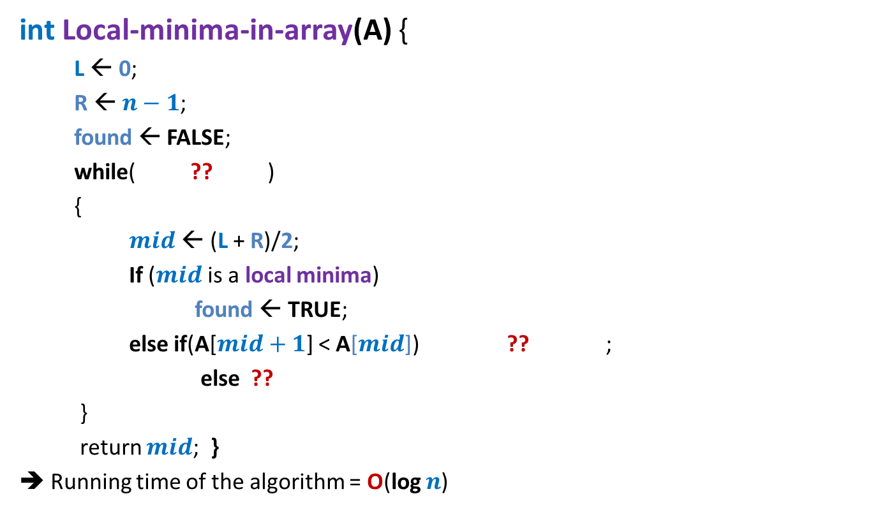

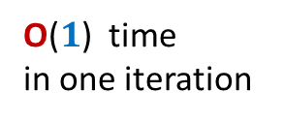

Local minima in an array (Similar to binary search)
int Local-minima-in-array(A) {
L ← 0;
R ← $n−1$;
found ← FALSE;
while( ?? )
{
$mid$ ← (L + R)/2;
If ($mid$ is a local minima)
found ← TRUE;
else if(A[$mid+1$] < A[$mid$]) ?? ;
else ??
}
return $mid$; }
➔ Running time of the algorithm = O(log $n$)
O(log $n$)
How many iterations ?
not found
O($1$) time
in one iteration
L← $mid+1$
R← $mid −1$
Proof of correctness ?

Slide 27




Proof of correctness
What can you say about the algorithm at the end of $i$th iteration.
P($i$) : At the end of $i$th iteration,
“A local minima of array A exists in A[$L$,…, $R$].”
Homework:
Make sincere attempts to prove the assertion P(𝑖).
Complete the proof.
$$L$$
$$R$$
A

Slide 28

Local minima in an array (Proof of correctness)
Theorem: A local minima in an array storing $n$ distinct elements
can be found in O(log $n$) time.

Slide 29

Local minima in a GRID
in O($n$log $n$) time

Slide 30
Local minima in a GRID
INCORRECT
Treat each row as an array and compute its local minima.
Reason: None of them may be the local minima of the grid.

Slide 31
Think …

Slide 32

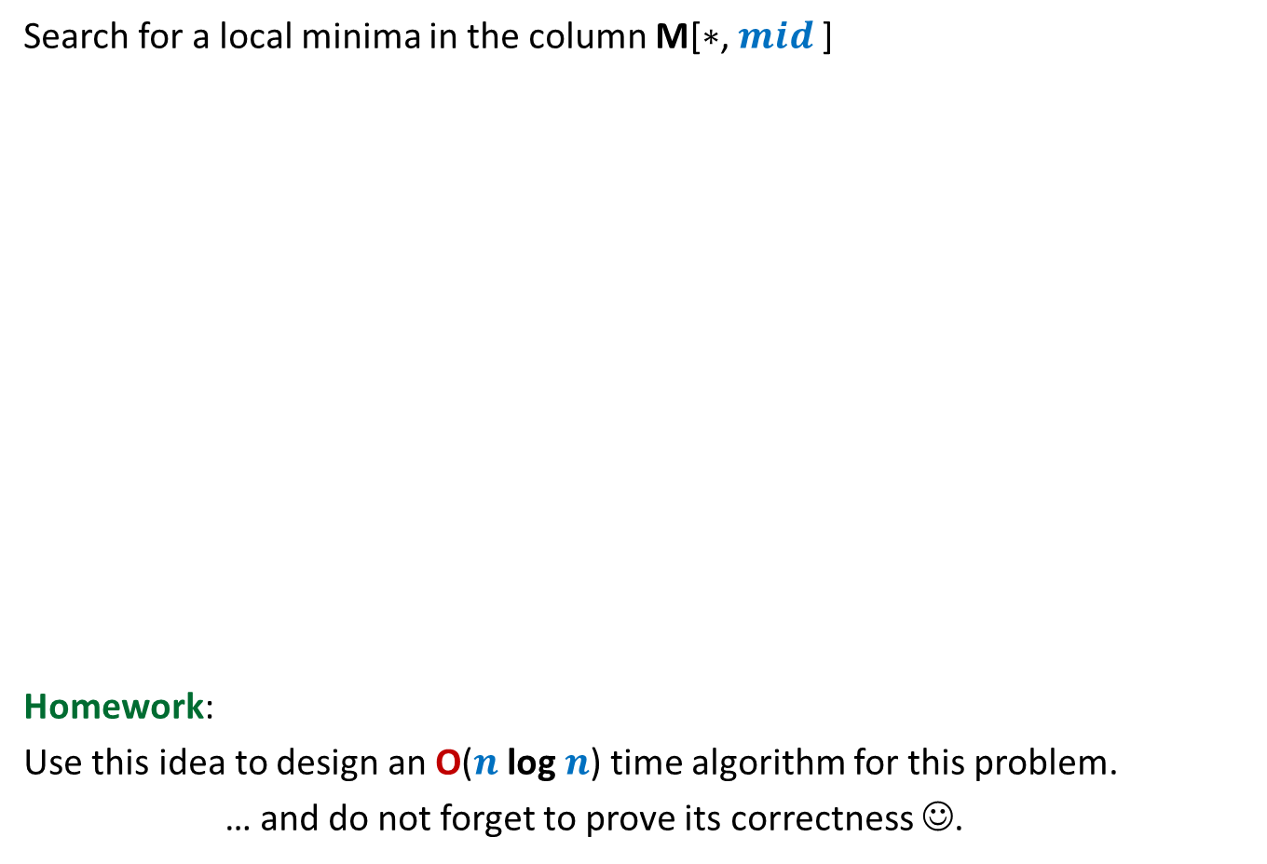


Local minima in a grid (extending the solution from 1-D to 2-D)
Under what circumstances even this smallest element is not a local minima ?
A local minima exists
in this region. Why ?
Search for a local minima in the column M[$∗$, $mid$]
Homework:
Use this idea to design an O($n$log $n$) time algorithm for this problem.
… and do not forget to prove its correctness ☺.
What if there is no local minima in the entire column.
Explore() from M[$i$, $mid+1$]
$$mid$$
Smallest element
of the column
$$i$$
9
7

